Slide 1

Capstone Project Financial Growth Audit for a B2B SaaS Company
Dominykas Datkūnas
July 3, 2026

Slide 2
Introduction
Dataset: AWS SaaS Sales (Kaggle)
Timeframe: 4 years (2020-2023)
Audience: Company’s executives
Company: Fictional B2B SaaS Company, providing sales and marketing software to large, global enterprises
Data: Completed sales transactions

Slide 3
Dataset limitations
No information on cancelled subscriptions (100% retention rate to be expected).
No information on Customer Acquisition Cost (CAC).
No information on monthly cash-flows.
Solution:
Feature engineering: yearly subscription, monthly MRR

Slide 4
Business objective
Where is profit loss occurring and how can we leverage high-value customer segments to drive further growth?

Slide 5
Contents
State of affairs
Causes of profit loss
What is holding back future growth?
Customer strategy
Recommendations

Slide 6
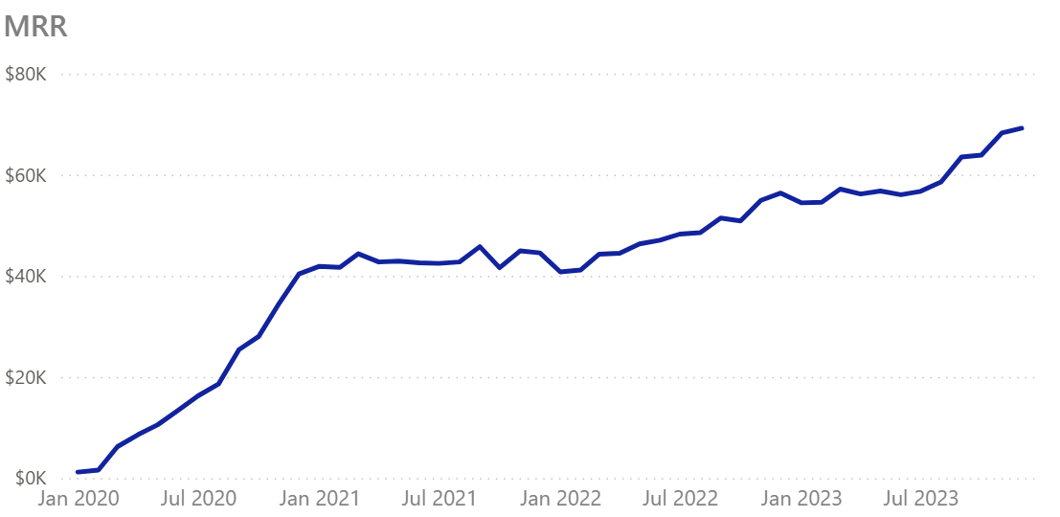
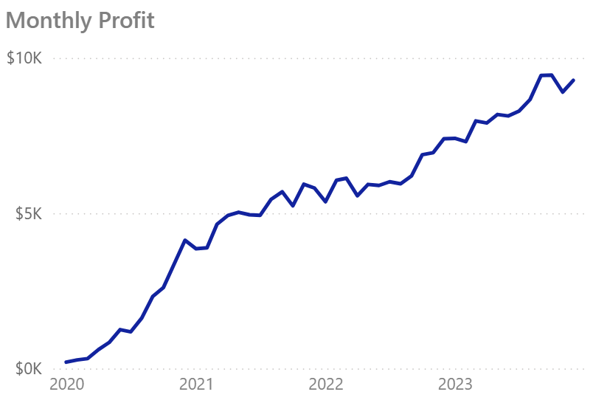
State of Affairs
Main trend – strong and steady financial growth
Monthly Recurring Revenue increased by 68% over 3 years, by 25% over last year.
Monthly Profit increased by 142% over 3 years, by 25% over last year.

Slide 7
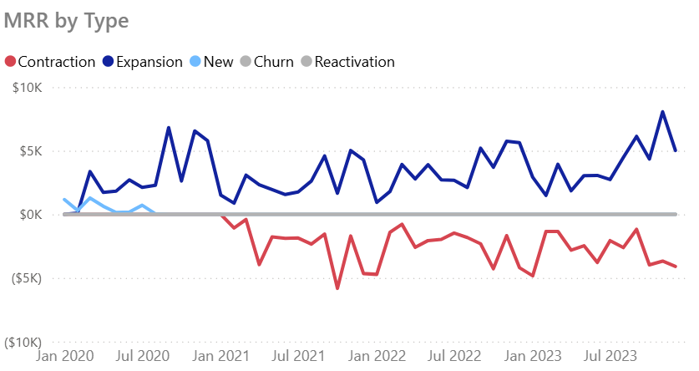
State of Affairs
No churn, No new customers for over 3 years
All growth since September 2020 driven by Expansion MRR.
All losses driven by Contraction MRR, not Churn.

Slide 8
Contents
State of Affairs
Causes of profit loss
What is holding back future growth?
Customer strategy
Recommendations

Slide 9
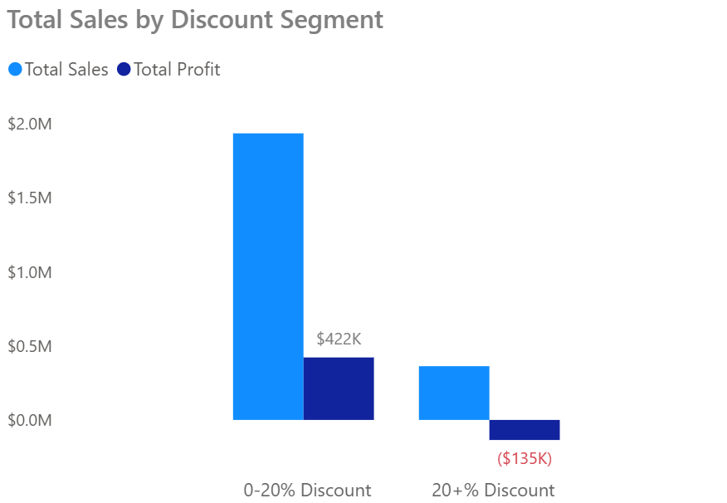
Causes of profit loss
A/B test. Excessive discounts drive profit loss
98% of transactions with a discount rate of over 20% have been unprofitable and resulted in $135k profit loss.

Slide 10
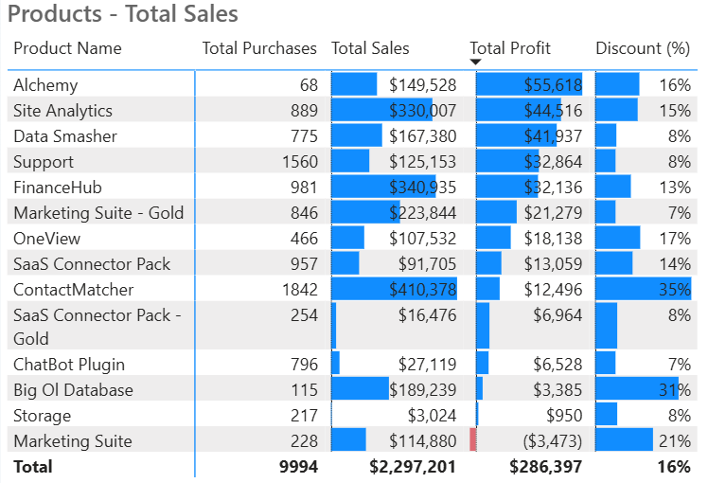
Causes of profit loss
Some products fall behind in profitability
Marketing Suite recorded a profit loss, which can’t be explained by a discount – further investigation required.

Slide 11
Contents
State of Affairs
Causes of Profit Loss
What is holding back future growth?
Customer strategy
Recommendations

Slide 12
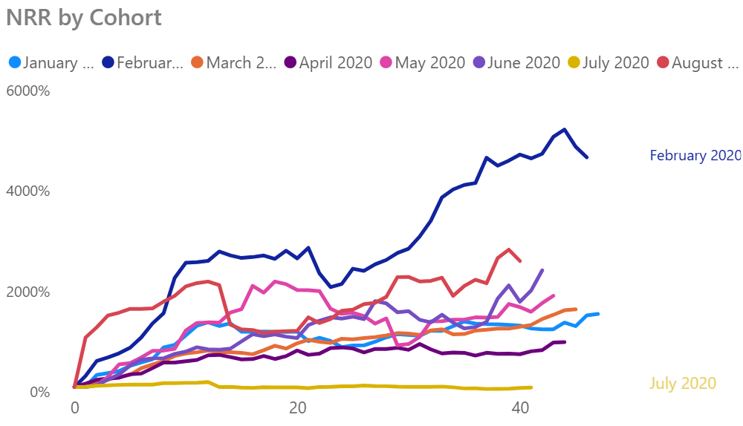
What is holding back future growth?
Growth is limited by lack of new customers
Net Retention Rate (NRR) has stabilized for majority of cohorts. New sources of revenue are needed in long term.

Slide 13
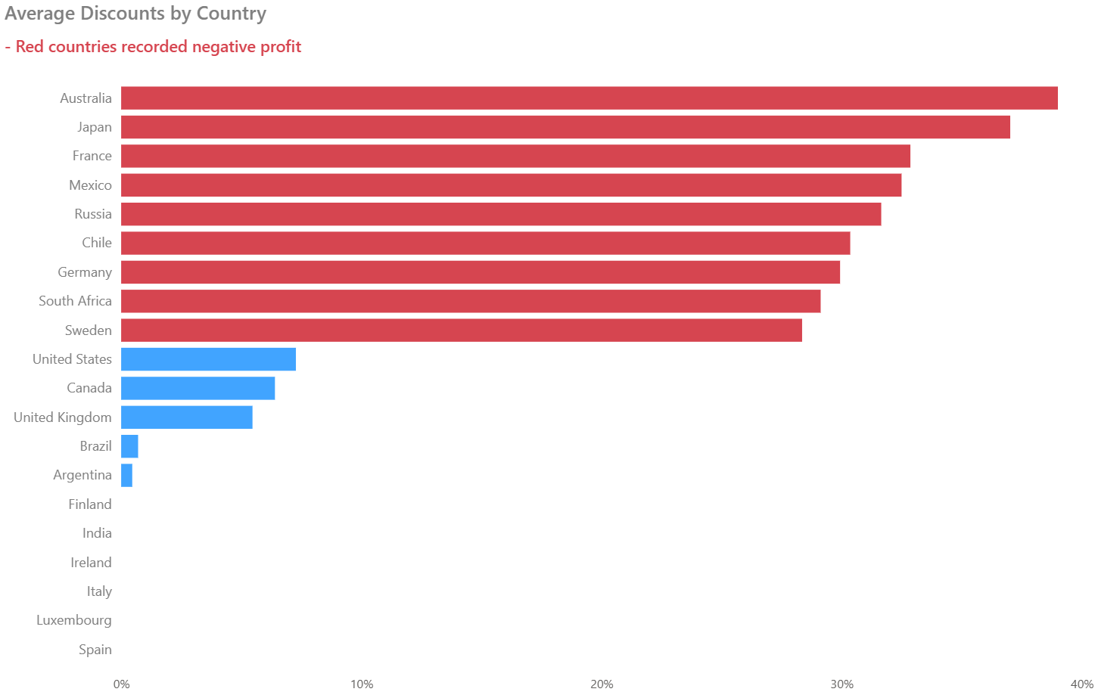
What is holding back future growth?
Uneven discounting practices across countries
Among countries that recorded a profit loss – all had high average discount rates.

Slide 14
Contents
State of Affairs
Causes of profit loss
What is holding back future growth?
Customer strategy
Recommendations

Slide 15
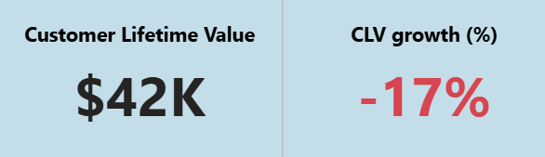
Customer Strategy
Calculating CAC for future customer acquisitions
Current CLV - $42k, which is 2x the revenue, customers have generated over 4 years.
CLV growth going down – possible indication that growth has stabilized.
Acceptable CAC when acquiring new customers: $8.4k - $14k.

Slide 16
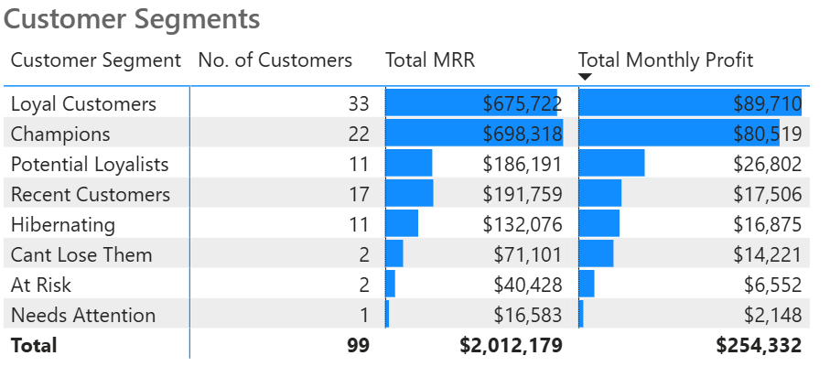
Customer Strategy
Customer base is already highly secure
55 out of the 99 active clients in highest value segments.
Only 4 – “At risk”, “Can’t Lose Them” segments.
For existing customers – double down on loyalty.

Slide 17
Contents
State of Affairs
Causes of profit loss
What is holding back future growth?
Customer strategy
Recommendations

Slide 18
Recommendations
Proposition
Strict 20% Discount Cap.
Acquire new customers.
Prioritize high value customer segments.
A/B test product viability (Marketing Suite).

